Slide 1
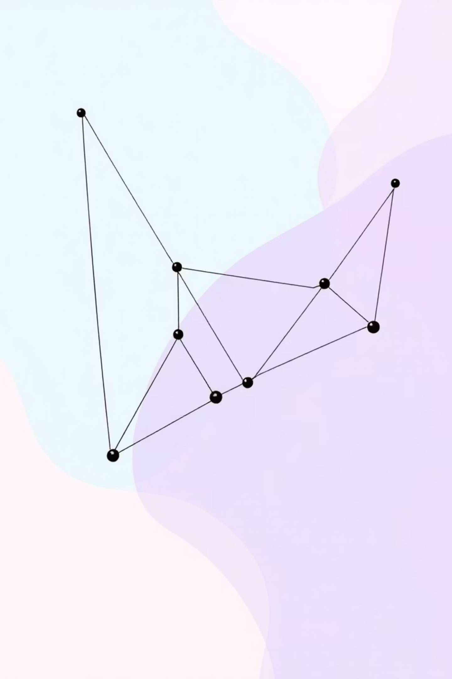

Jarvis March Algorithm
The Gift Wrapping Approach to Convex Hull Construction
Finding the smallest polygon containing all points in O(n·h) time

Slide 2

What is a Convex Hull?
Imagine stretching a rubber band around the outermost points. The resulting boundary is the convex hull—the minimal convex polygon containing all points.
Inner Points
Hull Points
Excluded from the hull
Form the boundary
Convex Property
No inward angles

Slide 3
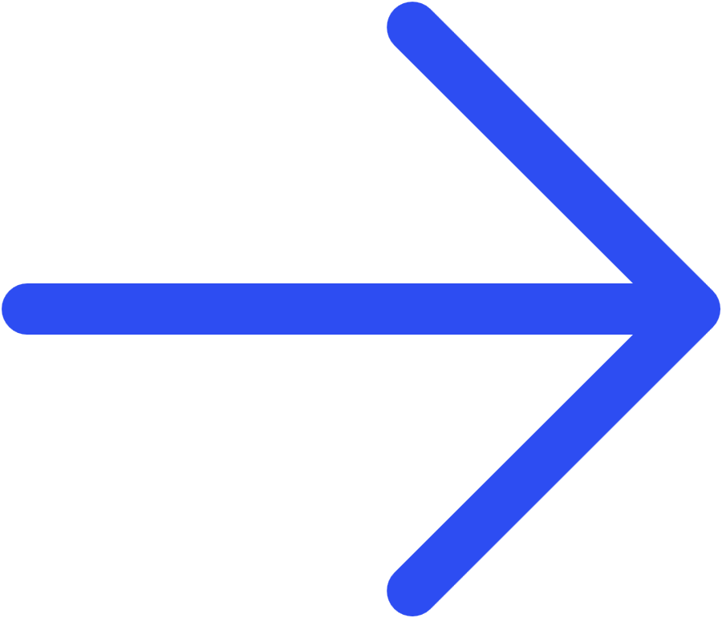
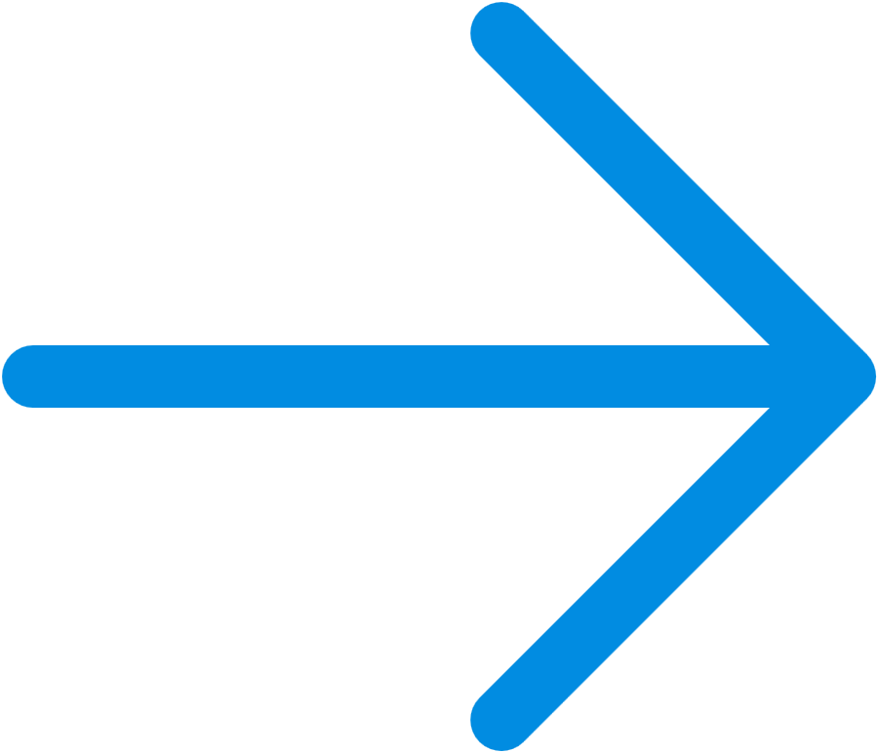
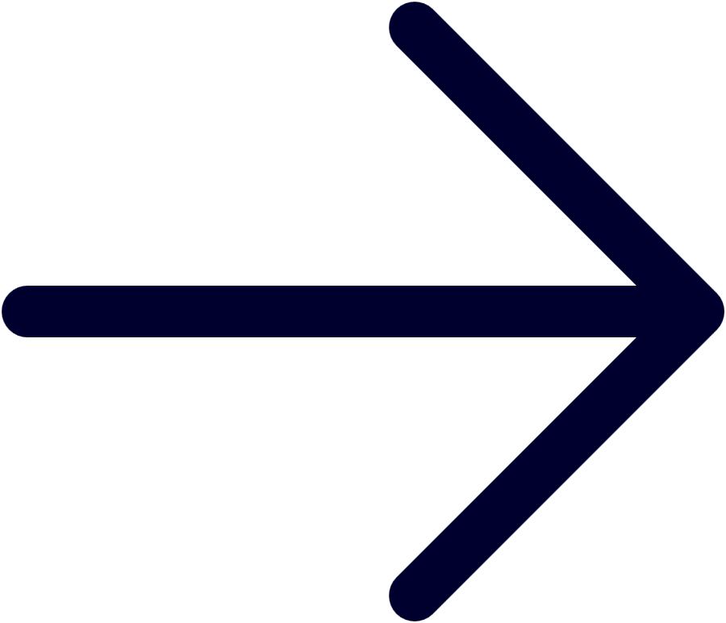
The Gift Wrapping Intuition
Start at the Lowest Point
Always begin at the southernmost point
Wrap Around Systematically
Turn counterclockwise to the next hull vertex
Check Every Candidate
Compare all remaining points for the sharpest turn
Stop When Complete
Return to the starting point

Slide 4
Algorithm Steps
1
2
Initialize
Select Current
Find point with lowest Y-coordinate (ties broken by smallest X)
Start hull construction from this point
3
4
Test All Points
Choose Next
For each unvisited point, calculate orientation relative to current hull edge
Select point making largest counterclockwise turn
5
6
Add to Hull
Repeat Until Done
Mark point as hull vertex, update current position
Continue until returning to starting point
Positive Result
Negative Result
Left turn (counterclockwise)
Right turn (clockwise)
Zero Result
Collinear (on the line)

Slide 5


The Cross Product Orientation Test
Cross Product Formula: For points P, Q, R:
Positive Result
Negative Result
Left turn (counterclockwise)
Right turn (clockwise)
Zero Result
Collinear (on the line)

Slide 6
Example: Seven Points Setup
Point
X
Y
Notes
A
0
0
Starting point (lowest Y)
B
2
0
C
2
2
D
0
2
E
1
1
Interior point
F
1
2
Interior point
G
2
1

Slide 7
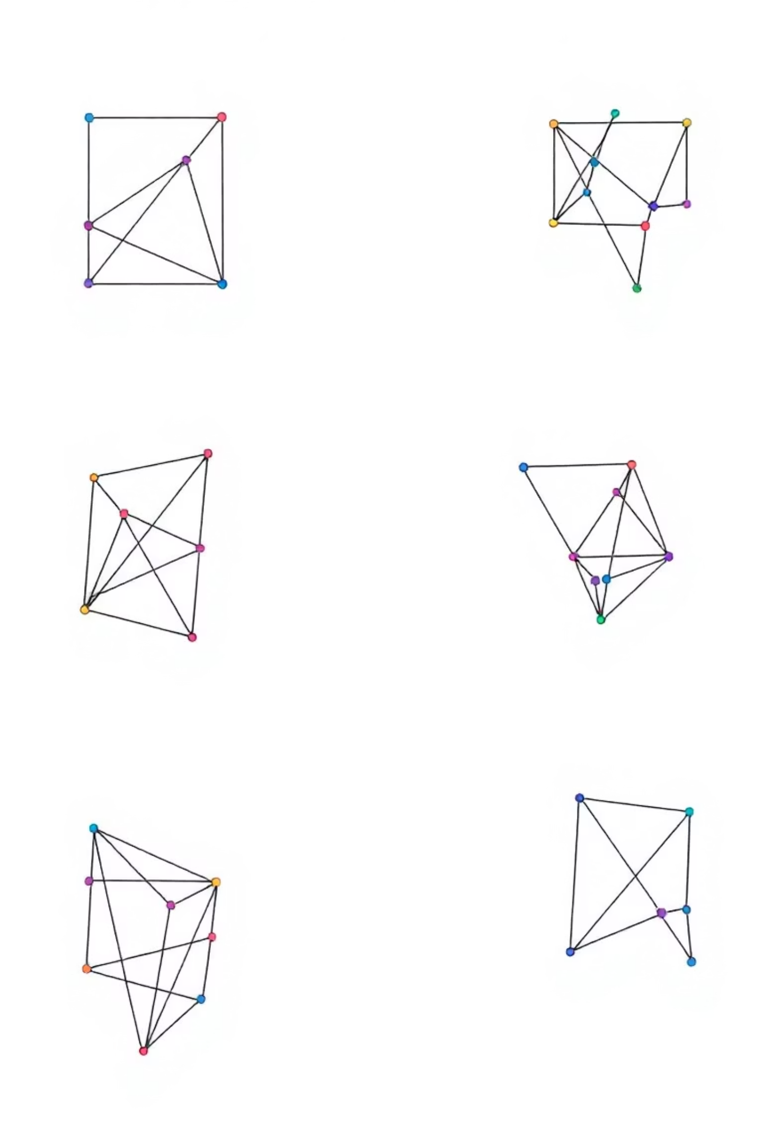
Step-by-Step Trace
1
From A(0,0)
Test all 6 points; choose B(2,0) for rightmost-most counterclockwise turn
2
From B(2,0)
Test remaining points; C(2,2) makes largest counterclockwise turn from edge AB
3
From C(2,2)
Test remaining points; D(0,2) makes largest counterclockwise turn from edge BC
4
From D(0,2)
Test remaining points; A(0,0) makes largest counterclockwise turn from edge CD—algorithm complete

Slide 8
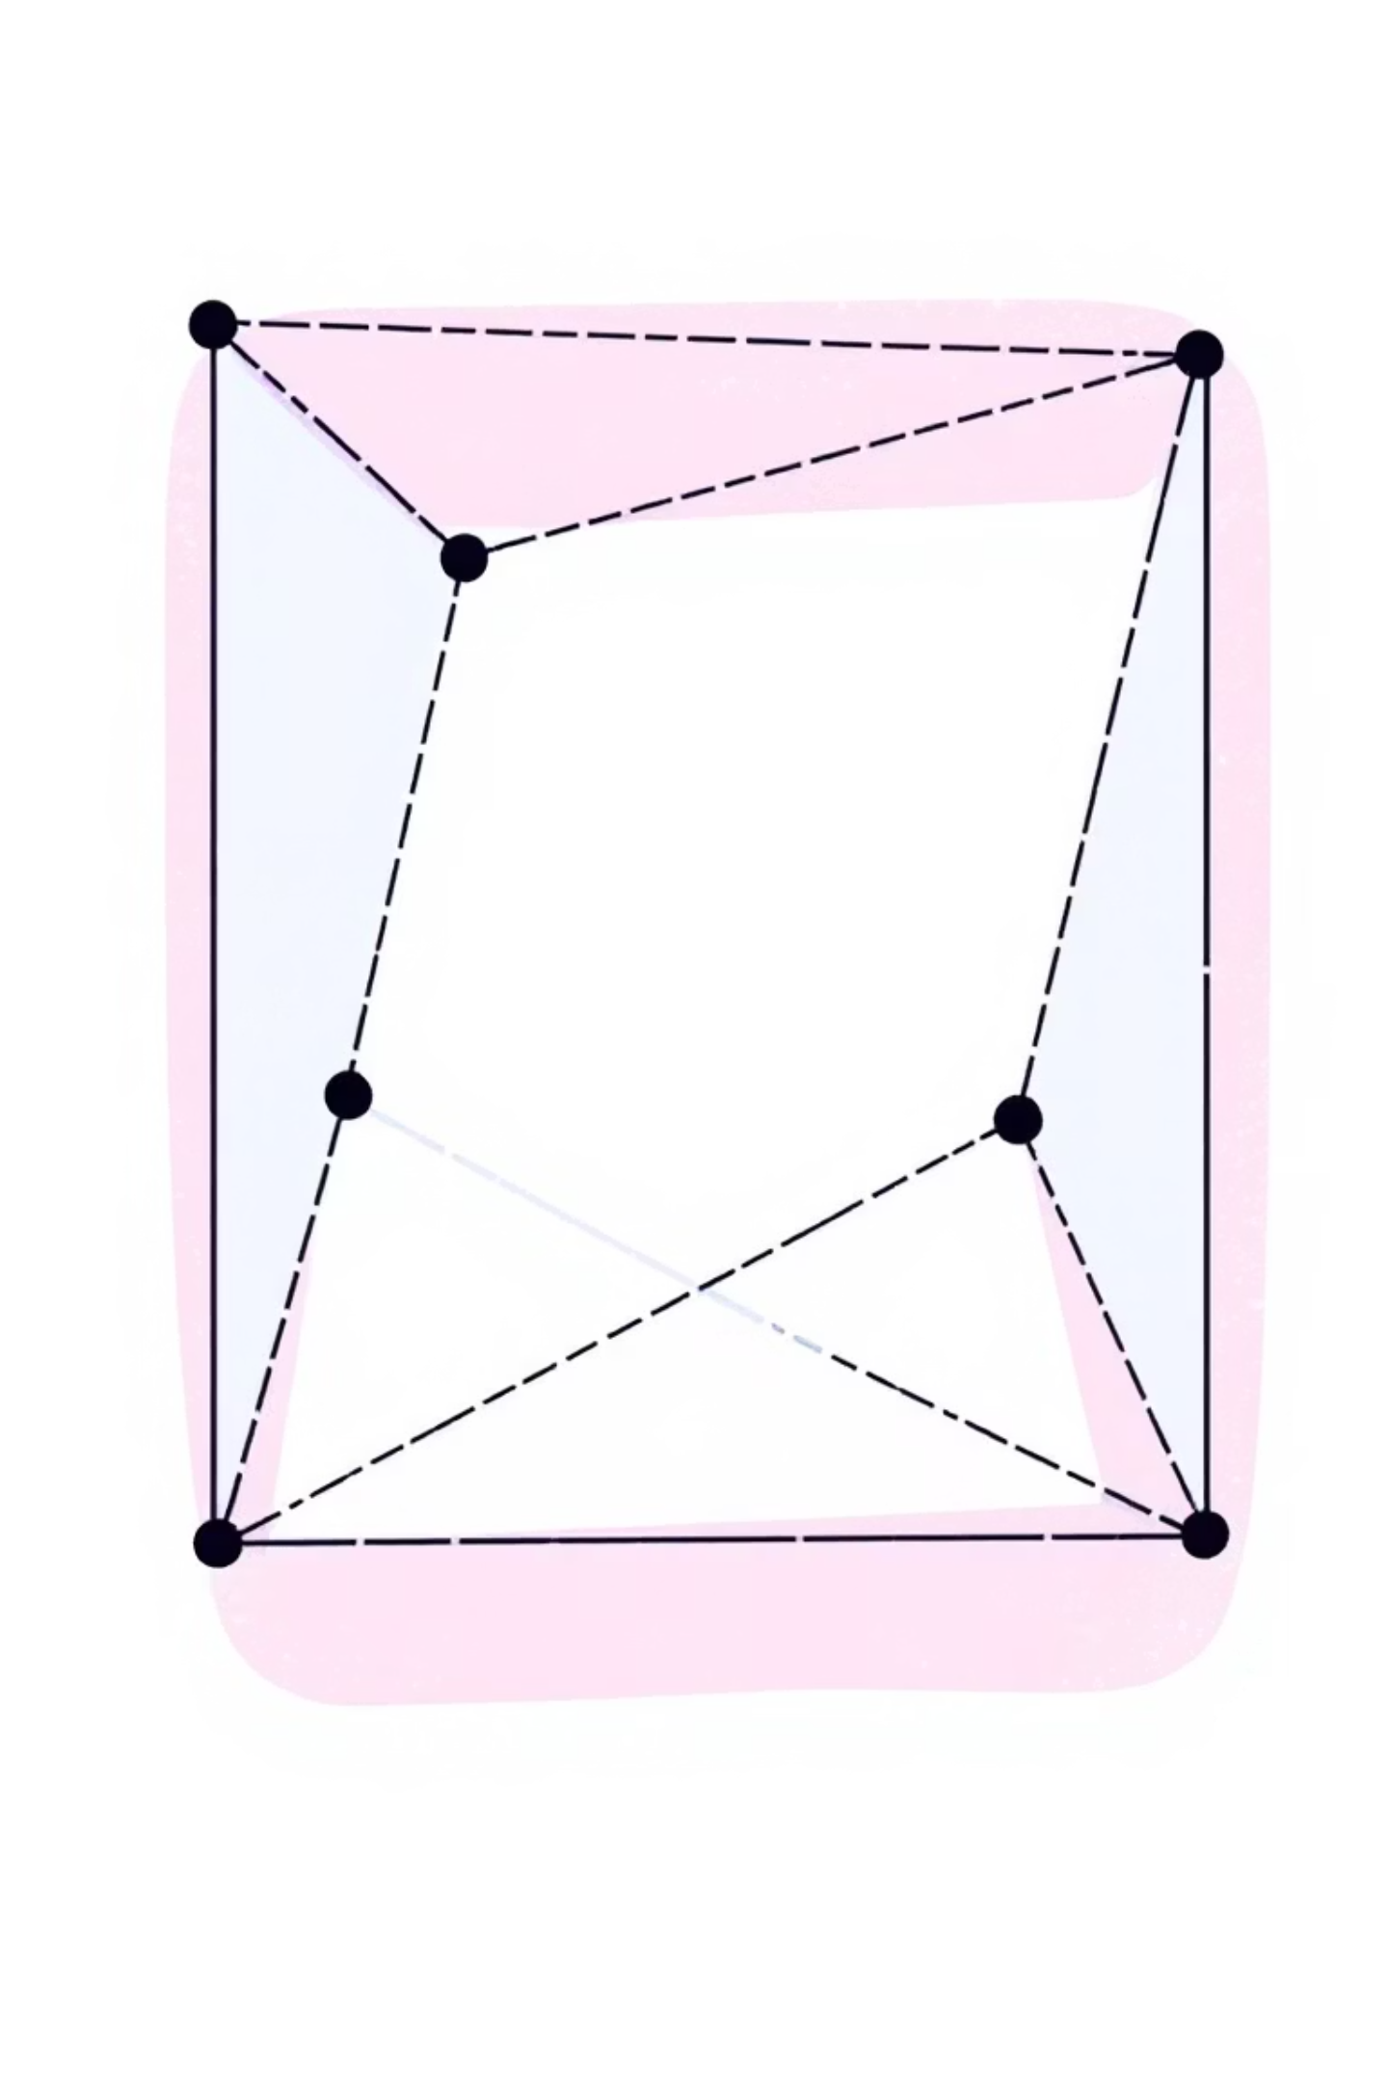
Final Convex Hull Result
Hull Vertices (in order): A → B → C → D → A
Hull Points
Interior Points
A(0,0), B(2,0), C(2,2), D(0,2)
E(1,1), F(1,2), G(2,1)
Hull Shape
Square with perimeter 8 units

Slide 9
Jarvis March vs Graham Scan
Aspect
Jarvis March
Graham Scan
Starting Point
Lowest Y coordinate
Lowest Y, then sort by angle
Time Complexity
O(n·h)
O(n log n)
Best Use Case
Few hull points (h small)
Large datasets (n very large)
Space Complexity
O(h)
O(n)
Approach
Sequential wrapping
Stack-based with preprocessing
Choose Jarvis: Small hull relative to n. Choose Graham: Large datasets requiring general efficiency.

Slide 10

Key Takeaways
Intuitive: Models the physical act of wrapping a string
Adaptive: Runs fast when few hull points exist
Practical: Used in graphics, robotics, and pattern recognition
The Jarvis March algorithm elegantly balances simplicity with efficiency, making it a powerful tool in computational geometry.

Slide 11
Code Walkthrough: Finding the Next Hull Vertex
Logic for Identifying the Next Hull Vertex
for check_idx in range(self.n):
if check_idx == p_idx:
continue
q = self.points[q_idx]
r = self.points[check_idx]
o, val = self._orientation(p, q, r)
# If the point is more counter-clockwise
if o == 2:
q_idx = check_idx
# If it's collinear, choose the farthest
elif o == 0:
if self._distance_sq(p, r) > self._distance_sq(p, q):
q_idx = check_idx
This code block is the core of the Jarvis March algorithm's iteration, responsible for selecting the next point on the convex hull.
Iteration: It loops through all points in the dataset (`self.n`) to compare each one against the current best candidate.
Exclusion: It skips the current anchor point (`p_idx`) itself, as it cannot be the next point on the hull.
Orientation Test: The `_orientation(p, q, r)` function (using cross product) determines if point `r` is counter-clockwise (`o == 2`), clockwise (`o == 1`), or collinear (`o == 0`) with respect to the vector `p` to `q`.
Selecting CCW Point: If `r` is more counter-clockwise than the current best candidate `q` (relative to `p`), `r` becomes the new `q_idx`.
Handling Collinearity: If `r` is collinear with `p` and `q`, the algorithm chooses the point that is *farthest* from `p`. This ensures that all extreme points on a collinear segment are included in the hull.

Slide 12

Code Walkthrough: Termination and Results
Advancing and Terminating the Loop
Finalizing and Reporting Results
p_idx = q_idx
# Check if we're back at the start
if p_idx == start_idx:
break
end_time = time.perf_counter()
self.h = len(self.hull)
self.time_taken_ms = (end_time - self.start_time) * 1000
yield {
'status': 'finished’,
'hull_so_far': self.hull,
'time_ms': self.time_taken_ms,
'complexity': f"Jarvis March:
O(nh) = {self.n} * {self.h} ops"}
This snippet performs two crucial actions:
Advancing the Current Point: p_idx = q_idx updates the current point in the hull construction. The point that was just identified as the "next" hull vertex (q_idx) now becomes the anchor point (p_idx) for the next iteration.
Termination Condition: The algorithm checks if the newly added point (p_idx) is the same as the initial starting point (start_idx). If it is, the convex hull is complete, and the break statement exits the main loop. This ensures the hull forms a closed polygon.
After the hull construction loop concludes, this code block handles the final steps:
Calculating Execution Time: end_time = time.perf_counter() records the timestamp, allowing for the calculation of the total execution time in milliseconds by subtracting the previously stored start_time.
Storing Hull Size: self.h = len(self.hull) captures the number of vertices found on the convex hull, which is important for understanding the algorithm's performance relative to the O(nh) complexity.
Yielding Results: The yield statement returns a dictionary containing the final status, the complete list of hull vertices, the measured execution time, and an estimated complexity string. This structured output provides a clear summary of the algorithm's execution and outcome.

Slide 13
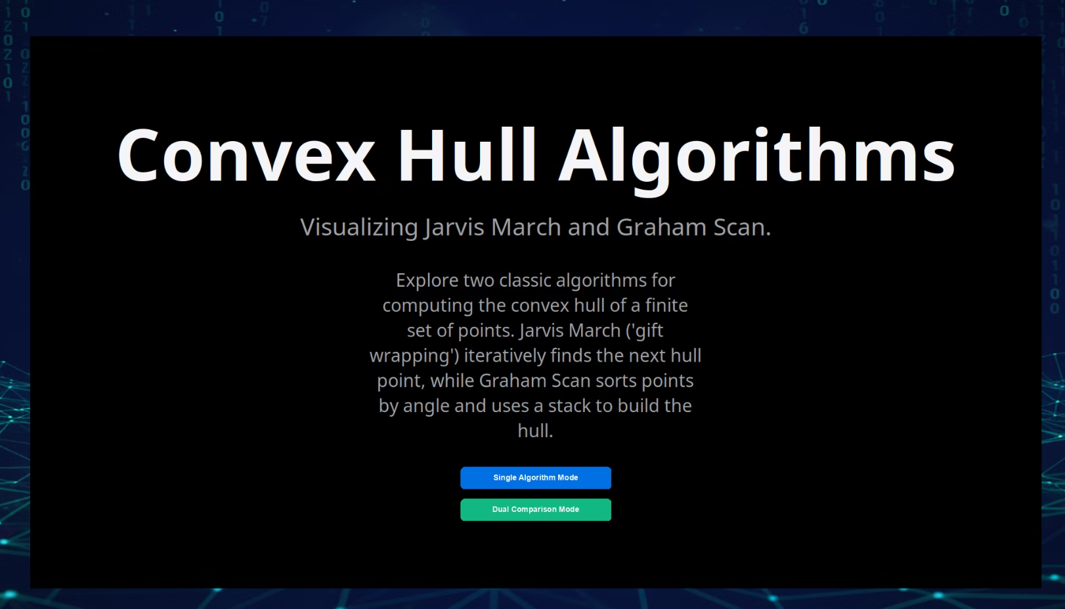
Start Screen
Here's the start screen. It consists of a simple explanation of what the program does, along with a clear title and two options:
single algorithm
dual algorithm

Slide 14
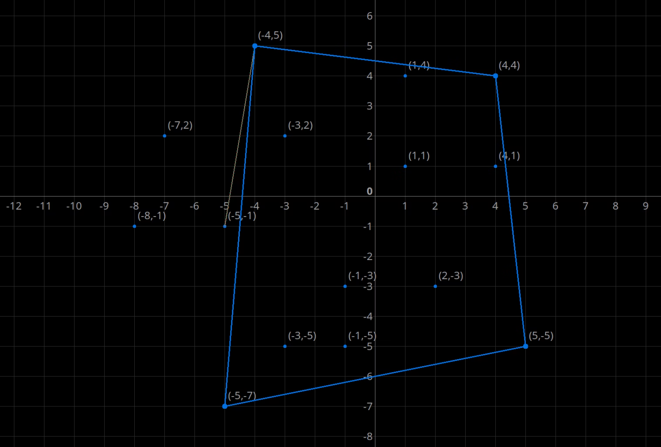
Running algorithm
The Jarvis algorithm works in its usual simple way. It starts by navigating between points to find the next correct step.

Slide 15
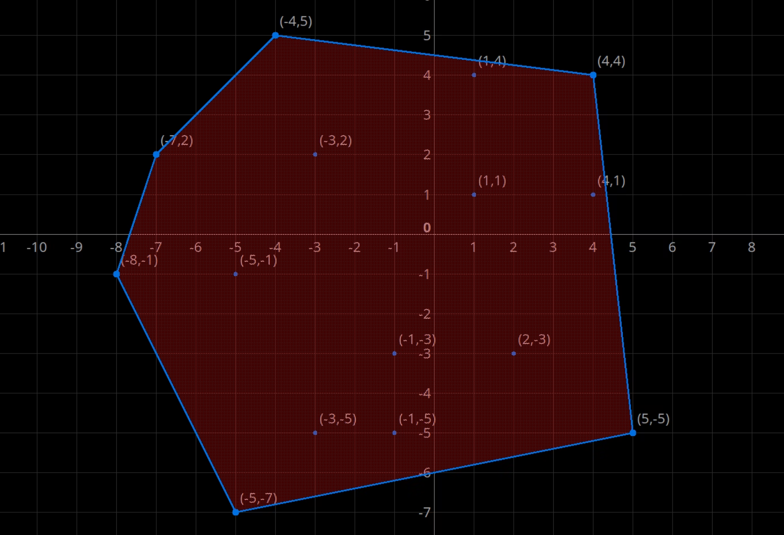
Finish algorithm
The program finishes applying the algorithm and displays it clearly: the vertices and edges are blue, and the entire area is colored red. The polygon appears here, which is, of course, a convex hull polygon.

Slide 16
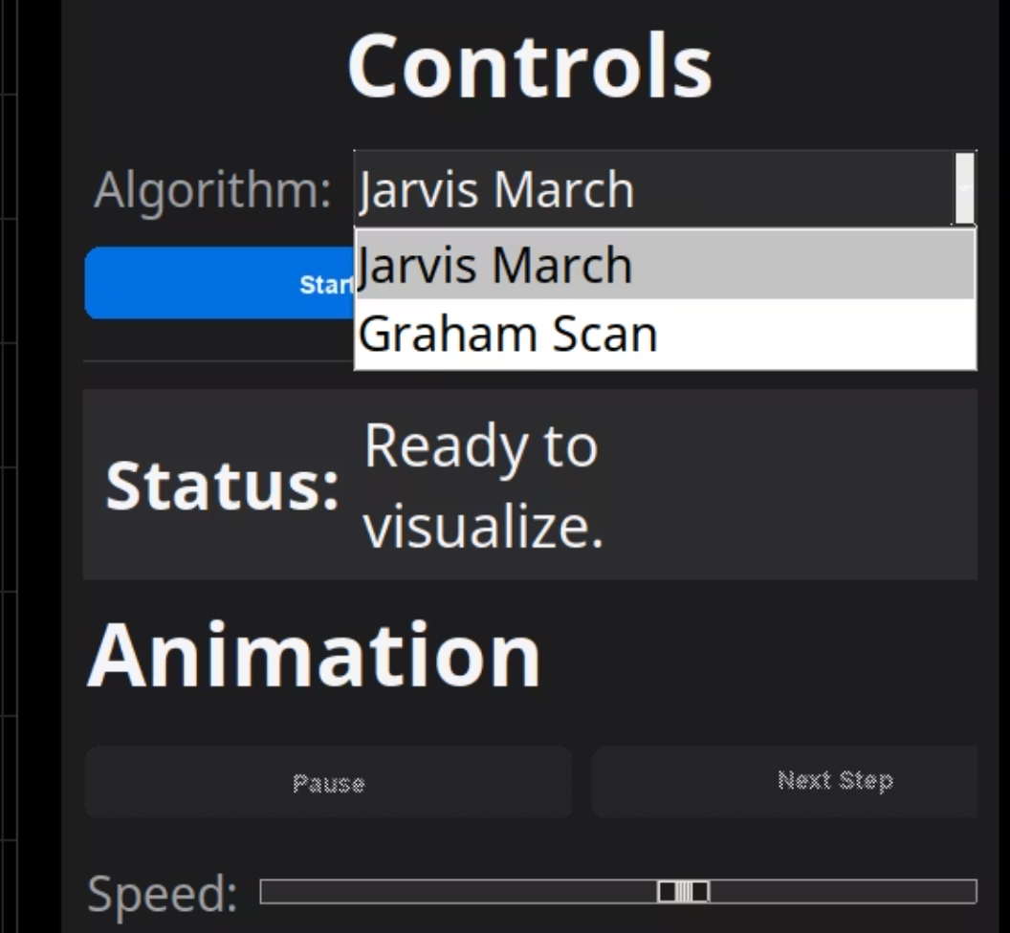
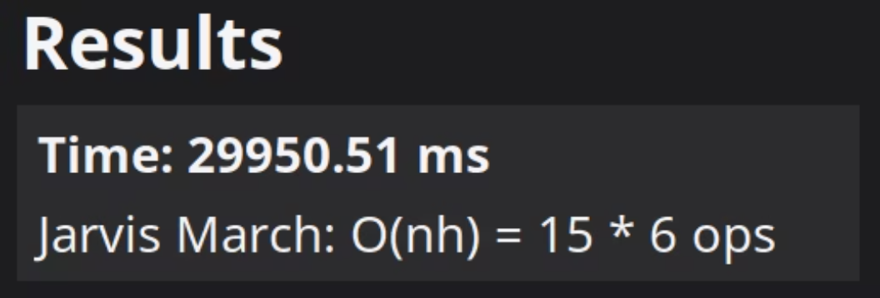
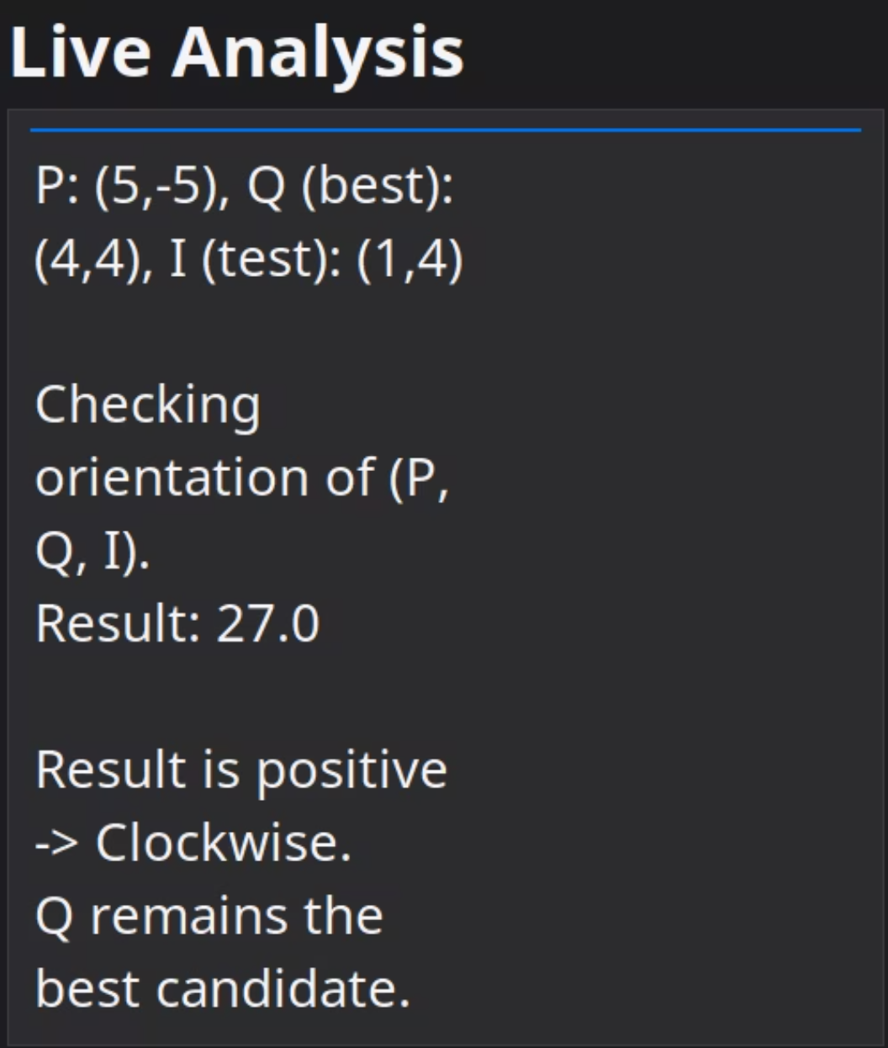
Result After finish
after finish. here the time take and the time complexity. O(nh)
Algorithm options
in single algorithm mode you can choose between the known algorithms
Live Analysis
During running, each equation and each step is shown here instantly.

Slide 17
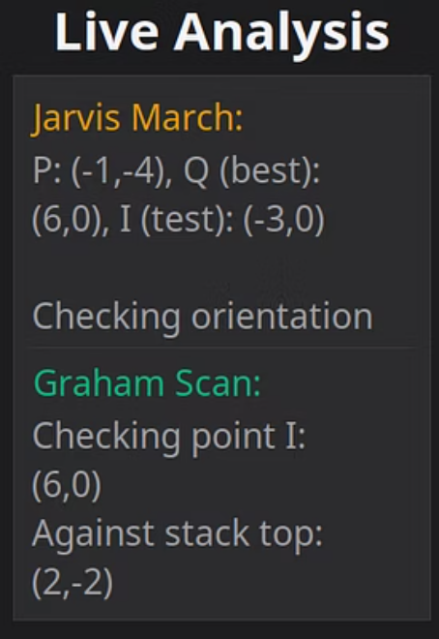
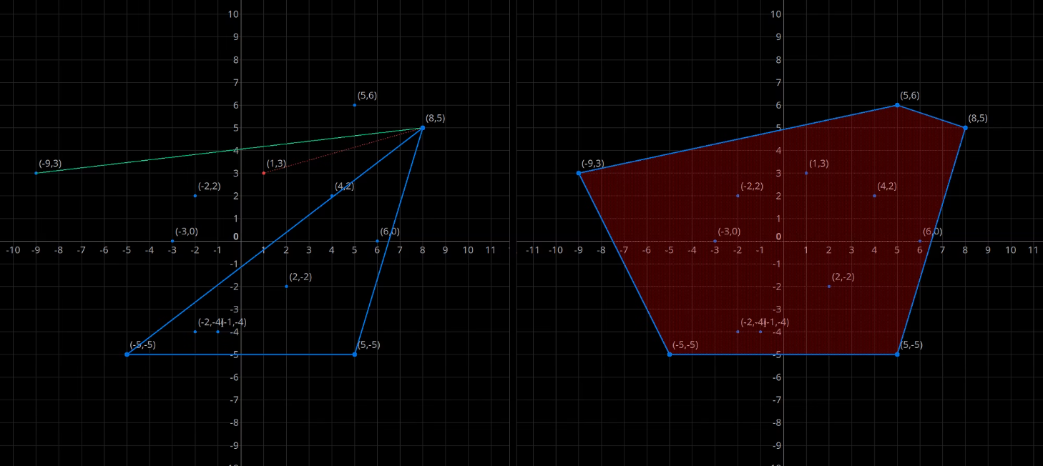
Dual Algorithm
Here, we can see how the dual mode works together for a clear comparison. The speed difference between the algorithms is also clear. The analysis is displayed immediately during running.

